Slide 1

Wish My Trip
Group Id: 25
Prasil Parmar (3044)
Raj Thakor(3081)
Keval shah (3228)
Submitted to:
K. S. School of Business Management
M. Sc. – Computer Applications and Information Technology

Slide 2
ORGANIZATION PROFILE
Company Name: IndiAir Services
Established: In 2015
Postal Address: C-112, Ganesh Meridian Opp Kargil Petrol Pump S.G. Highway, Ahmedabad, 380060
Email: Intl@indiairservices.com
Website: www.Indiairservices.com
Contact: 9913555255/9913455255
Company History
Indi Air Services, founded by Mr.Sanket Dave in 2015, has been active in the incoming Tourism segment, enjoying every year dynamic growth in terms of arriving passengers and revenue.
Capitalizing the growth deriving from the new destinations, as well as the growth of many new source markets, the company`s boost has positioned it to one of the most extended and geographically diversified incoming networks and Destination Management Companies, serving more than 250,000 passengers in a year.
Mission
Efficiency, Flexibility and Quality Service with a Personal Touch, State of the Art Technology, combined with strong purchasing advantages and Value for Money.
We’re committed to offer competitive value for money products and high level services in order to achieve total client satisfaction. We want to meet and exceed all business clients goals and objectives, strive for excellence in quality, integrity, and value in all that we do. We want our partners and ourselves to grow profitably in our respective countries, through thorough market analysis, continuous product development, aggressive yield management and prudent financial risk monitoring.

Slide 3
Table of Contents
Existing System
Proposed System
Scope of System
Objectives of System
Stakeholders of System
Project Definition
Feasibility Study
Hardware – Software Requirements
Gantt Chart and Work Breakdown Structure – Diagram
UML Diagram
System Flow Diagram
Data Dictionary
User Interface
System Navigation Diagram
Limitations
Future Scope
Bibliography

Slide 4
Existing System
All Work are done manually.
In Manual Car Booking System Customer has to go to the Travelling office.
Ask Inquiry for Travelling then Book car Finally Pay Payment & Collect Receipt.
Difficult to Maintain the Customer Details of Payment Receipt in Register.
They Register Car Package in the notebook.
Add advertisement in Local newspaper or Local Market.
Use Travelling Facility For the Limited Area or Person.
You cannot get all the traveller Details at one Place.

Slide 5
Proposed System
To Create Web Based Application for our Organization.
To Provide Search Facility for Customer.
To Generate Different Types of Reports.
To provide the online Car Booking and Online Payment Facility for Customer.
To Provide Car Details.
Customer does not need go to anywhere for Booking of Car.
Customer can get all the details of travellers at one Place.
Customer Can Cancel the Booking Before 24 Hours at 0 Cost.
Customer can give feedback.
Customer can hire Car for more than 1 day.

Slide 6
Scope of System
Easily booking of car.
Online payment is possible.
User can get reminder of his booking.
User can search cars.
User can search travel agencies.
User can be able to see his past booking.
User can manage his own profile.

Slide 7
Objectives of System
User can get the rate of cars of different travel agencies at one platform.
Opportunities for business of travellers increase.
User can select the car on the basis of his budget.
User can get the suggestion to travel.
User can also be able to get knowledge of hotels at his destination.

Slide 8
Stakeholder of System
The following stakeholders for our system are:
Admin
Users
Transport Providers

Slide 9
Admin
He is the whole and sole authority of the system who has all the rights regarding to the system.
He can update the schedule, delete the user, delete the traveller.
He can create the offers for customer.

Slide 10
Users
A user is a customer who makes bond with the system and take benefit of the services provided by the system.
A user is a customer who can book car online.
A user does payment.
A user does cancellation of booking.
A user can give feedback for the system.

Slide 11
Transport providers
He can provide all the details regarding the vehicles.
He can update the cars information.
He can create the deal for customers.

Slide 12
Project Definition
Our Project is to book car online where one can rent a car of their choice. So, our Websites creates a Digitalize platform for the users who can book a car online from anywhere and at any time.

Slide 13
Feasibility Study - I
1. Technical feasibility
The technical feasibility study compares the level of technology available in the software development firm and the level of technology required for the development of the product. Here the level of technology consists of the programming language, the hardware resources, other software tools etc.
The facility to produce outputs in a given time.
Response time under certain conditions.
Facility to communicate data to distant locations.
It just requires window operating system and normal browser to use our system.
The organization has already purchased required gadgets.
Hence, the proposed system is technically feasible.

Slide 14
Feasibility Study - II
2. Operational feasibility:-
Operational feasibility study tests the operational scope of the software to be developed. It is checked that if the system is actually can be useful when implemented.
Our system is operationally feasible in the following ways:
Since the employees are well educated and knows the importance of computer in day to day life, they have shown the positive response to our system.
The system does not have specific hardware/software requirements. Any user will be able to use this website on its comprehensive desktop.

Slide 15
Feasibility Study - III
3. Economical feasibility
The economic feasibility study evaluates the cost of the software development against the ultimate income or benefits gets from the developed system. There must be scopes for profit after the successful Completion of the project.
The system is economical feasible because:
Our system is not much costly to develop.
There is no extra economical cost because system is develop with an open source technology.
It is easy to use and understand therefor there is no need to appoint any operator to use the system.
Organization is ready to invest in proposed system because it is being developed in latest technology and will be very fast for the users to transfer or share the information using the system.

Slide 16
Hardware and Software Requirement
Hardware Requirements
Processor | Intel P4 and higher and/or equivalent processor system.
Hard disk | 40 GB or above.
RAM | 512 MB and above.
Software Requirements
Platform | PHP,ANGULAR
Frontend | Sublime or Visual studio code
Back end | My SQL
Tools | JQuery
Web Service | JSON

Slide 17
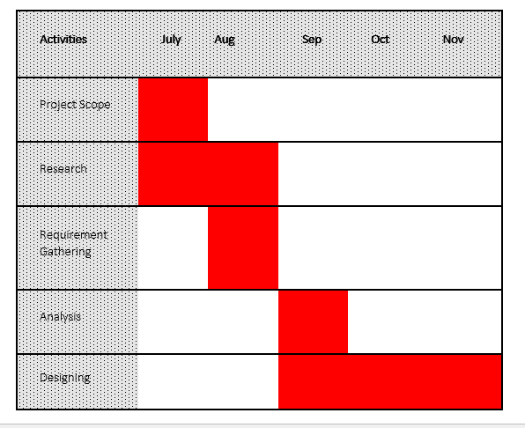
Gantt Chart

Slide 18
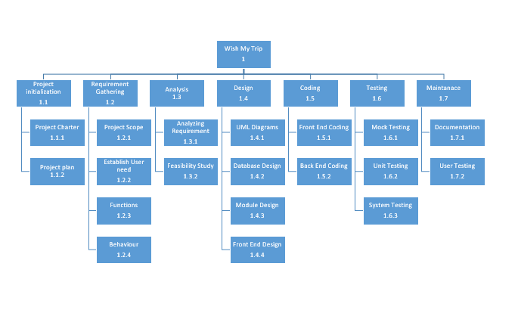
Work Breakdown Structure

Slide 19
UML Diagram

Slide 20
List of Figures
Use Case
Class Diagram
Activity Diagram
Sequence Diagram

Slide 21
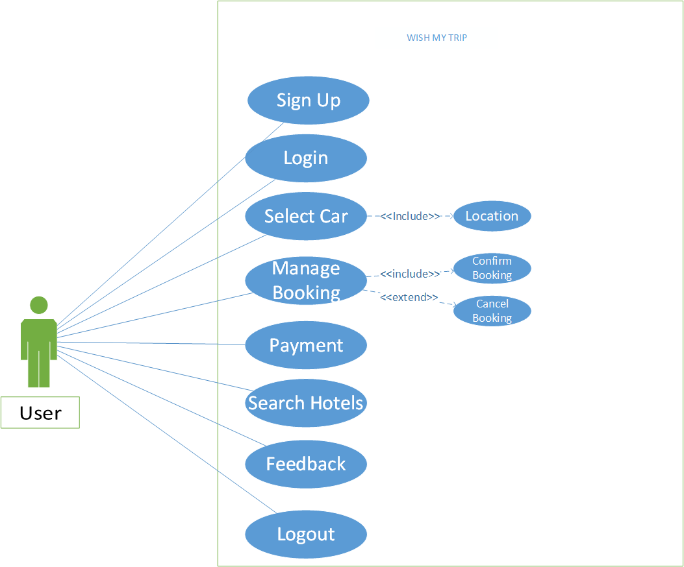
Use Case

Slide 22
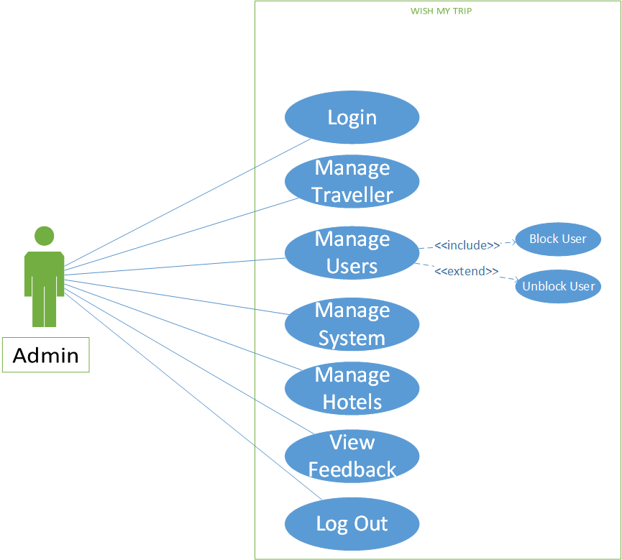

Slide 23
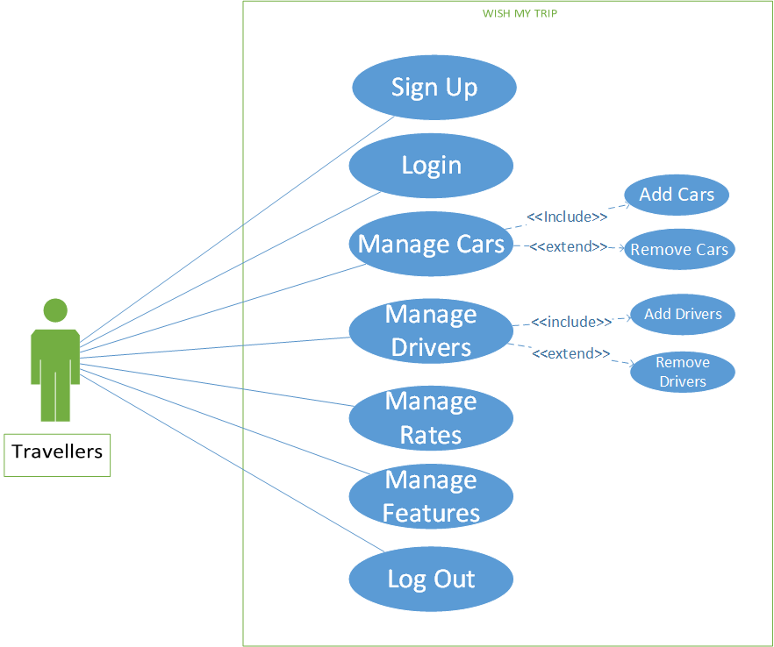

Slide 24
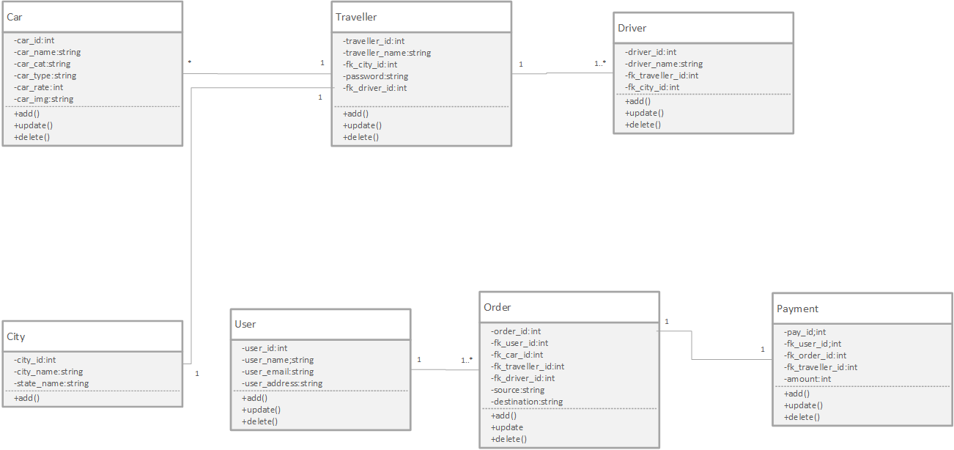
Class Diagram

Slide 25
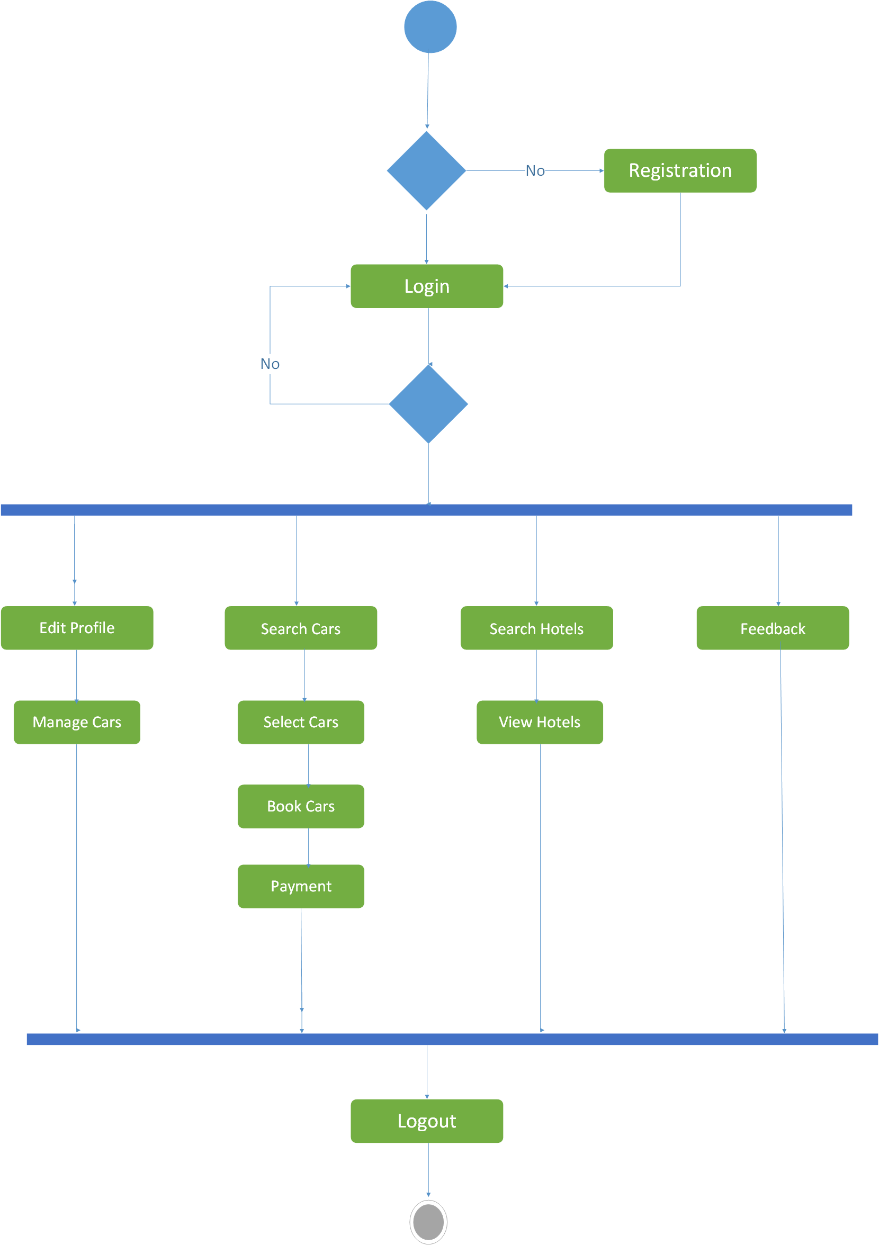
Activity(User)

Slide 26
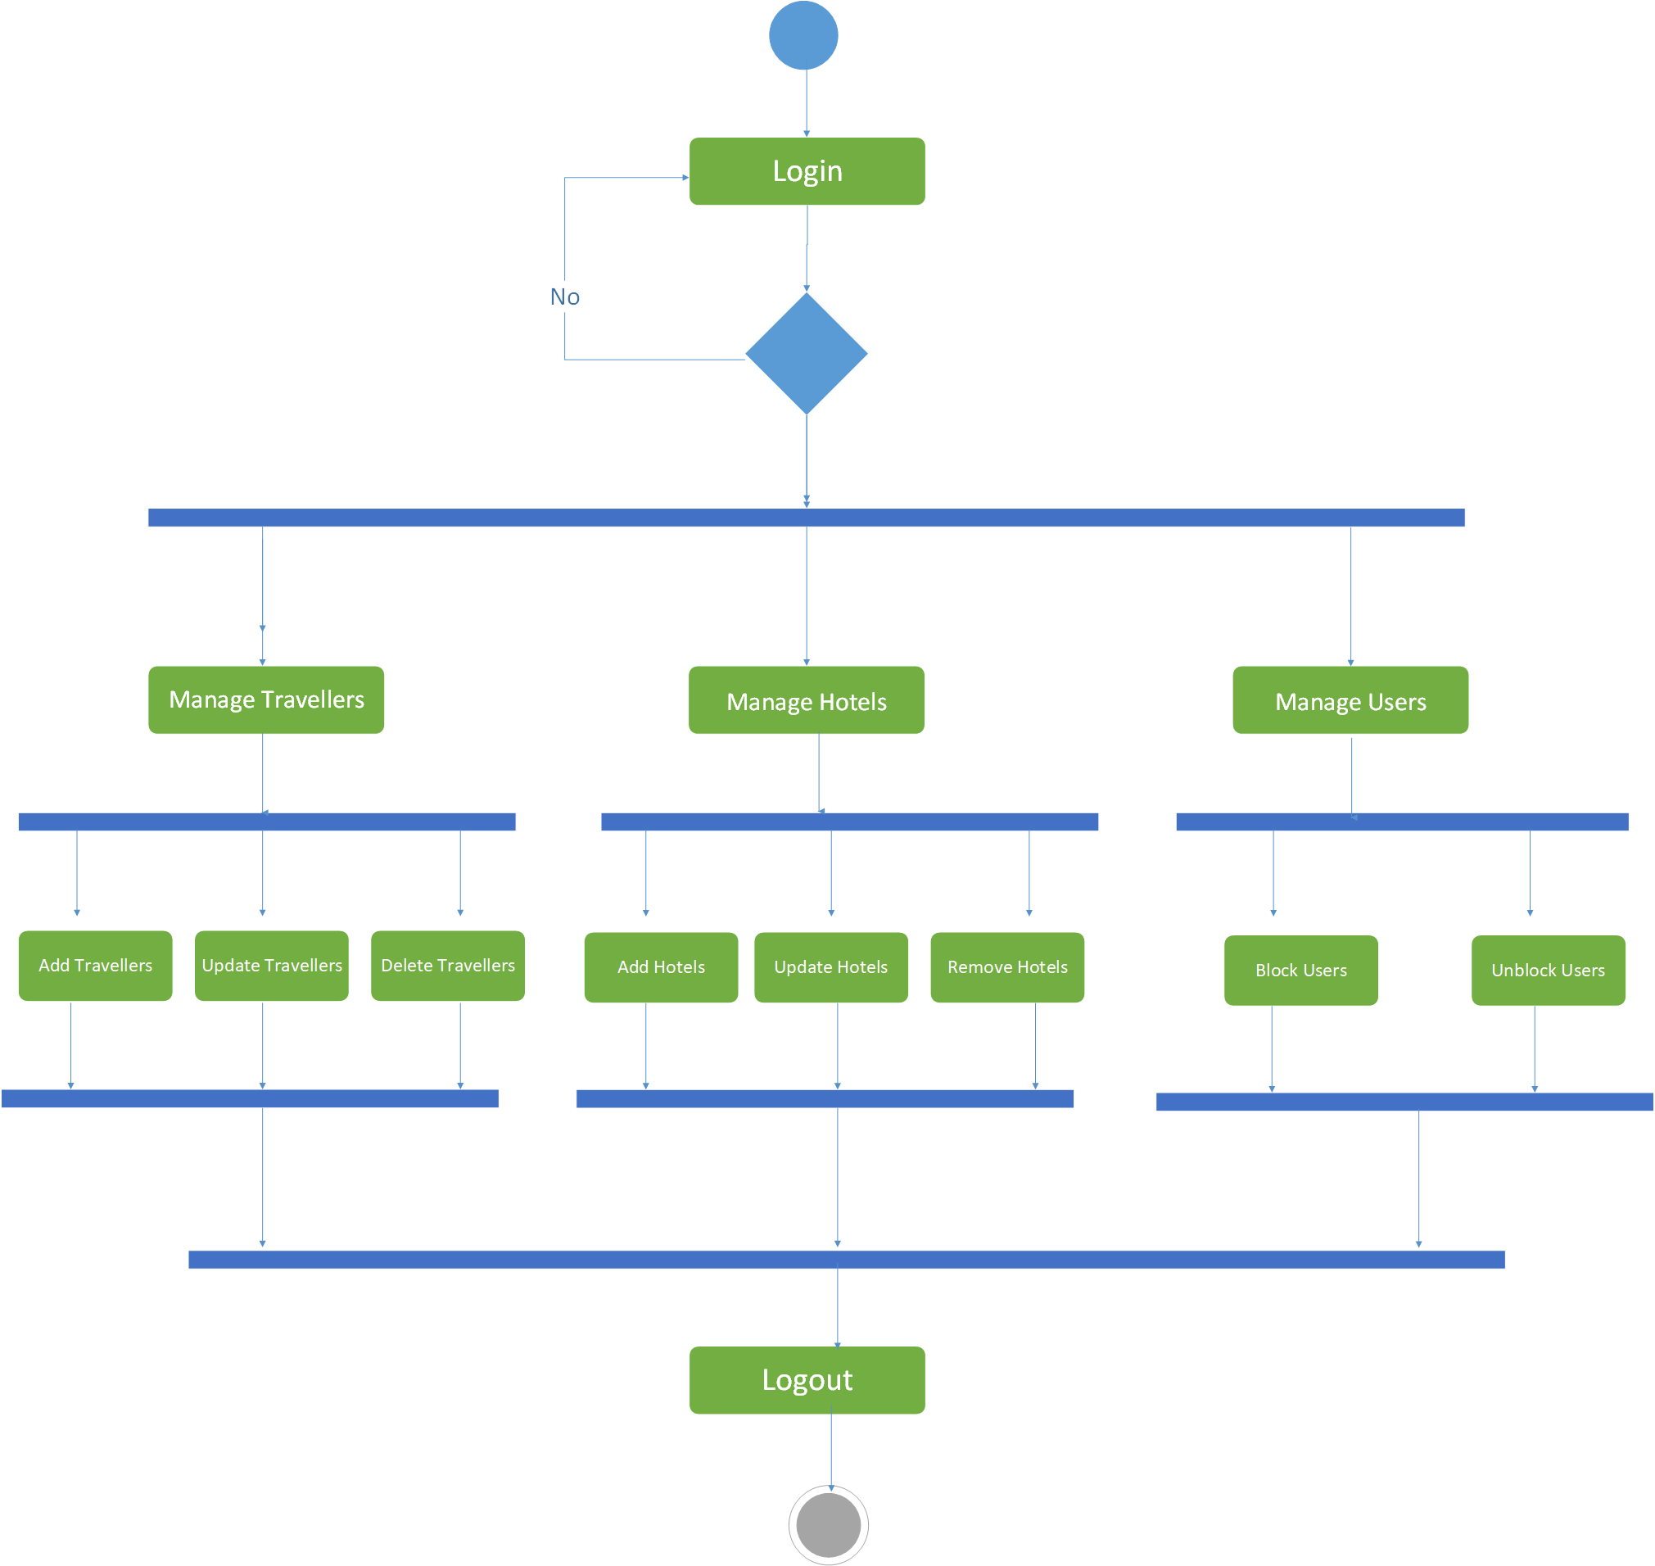
Activity(Admin)

Slide 27
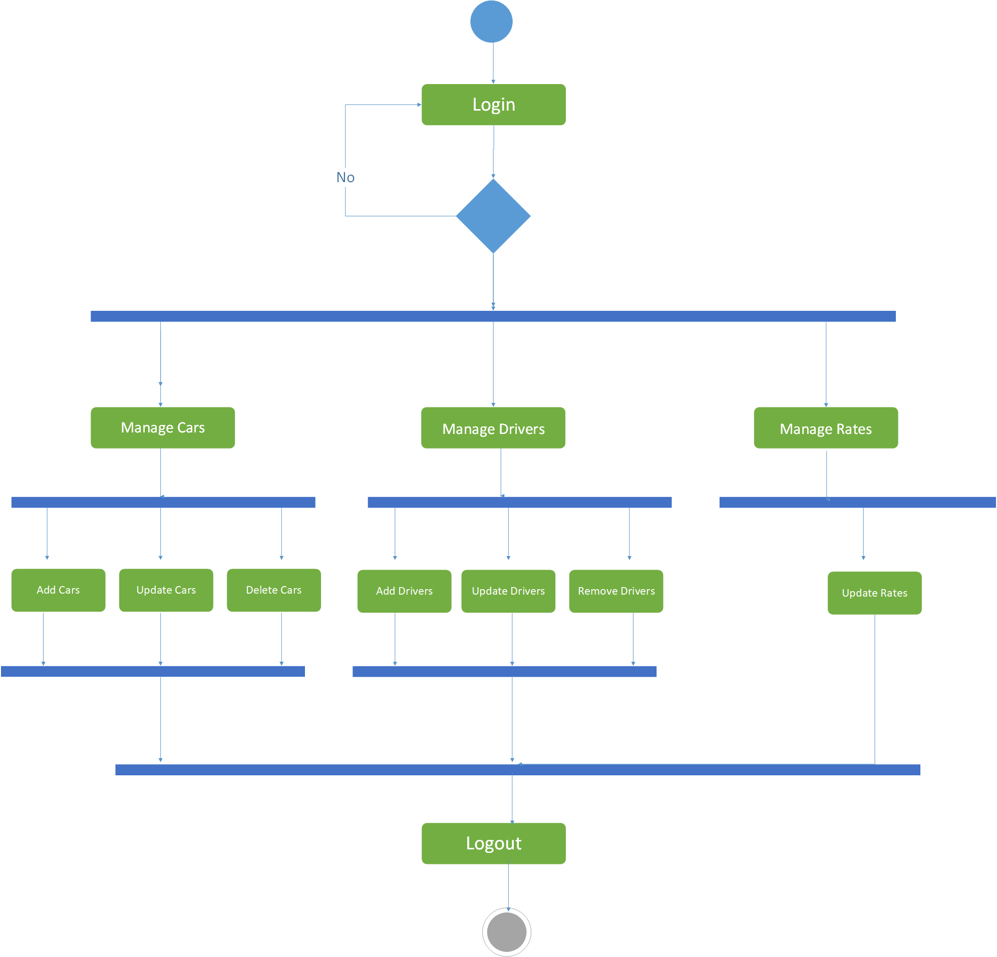
Activity(Travellers)

Slide 28
Sequence Diagram-I

Slide 29
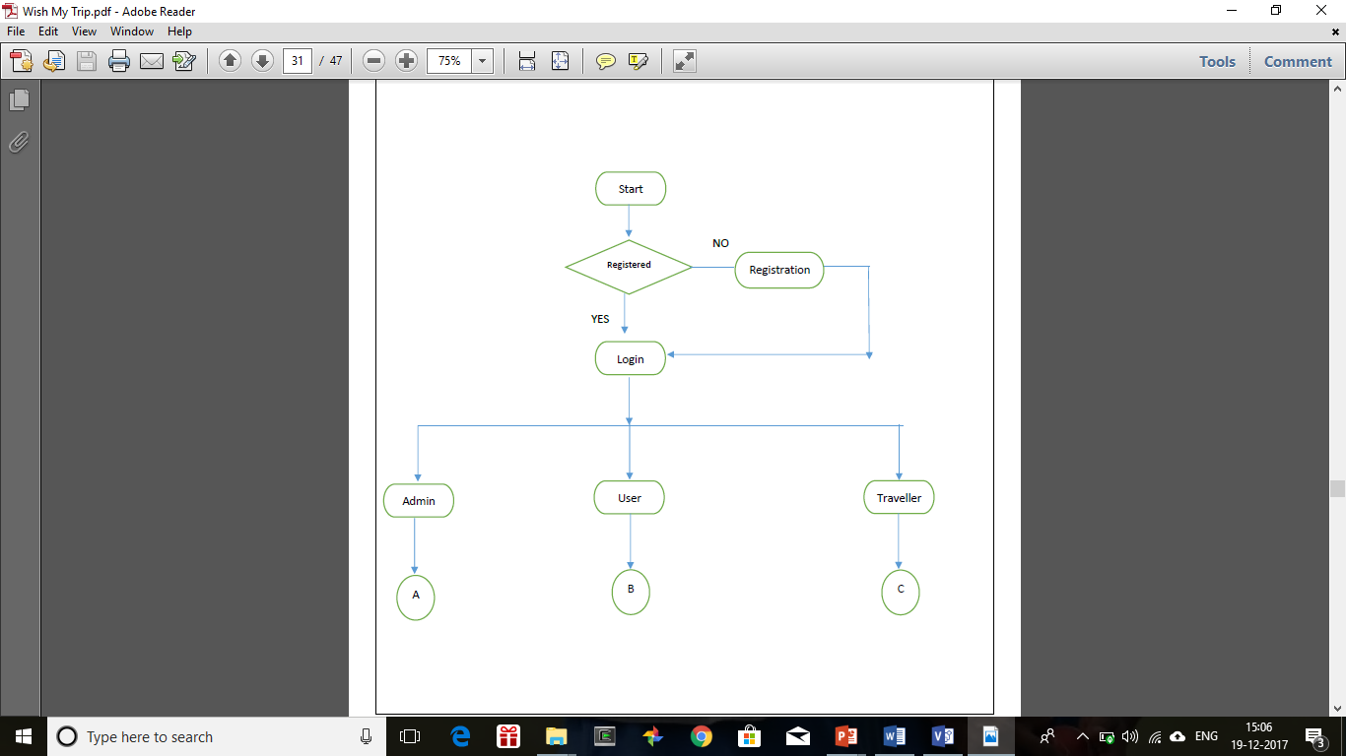
System Flow

Slide 30
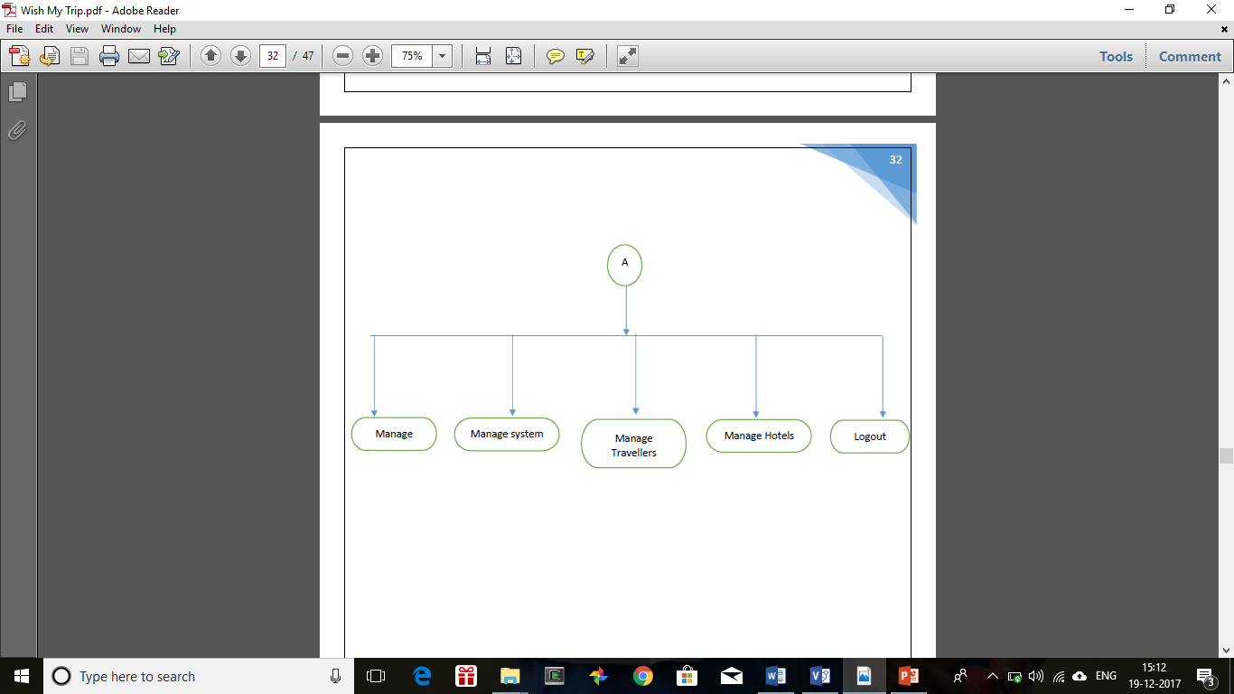

Slide 31
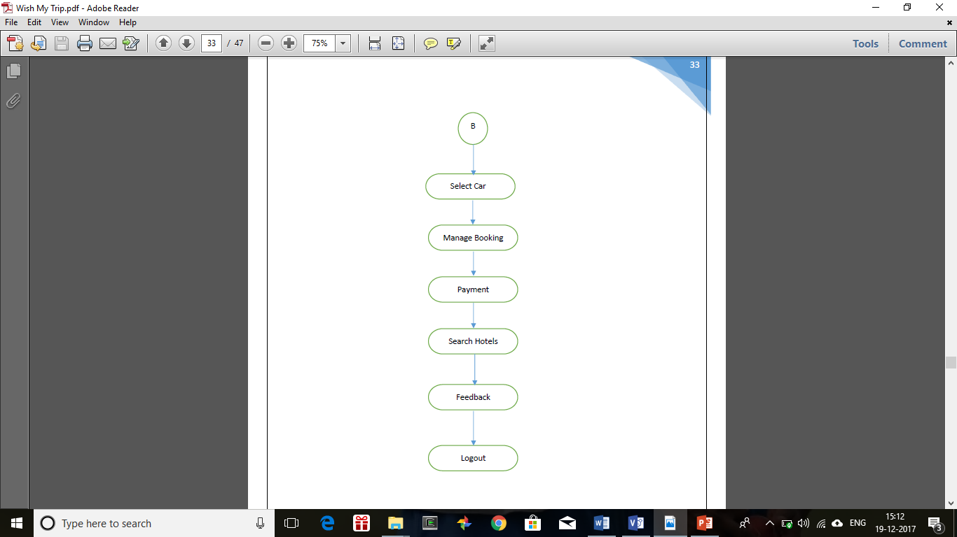

Slide 32
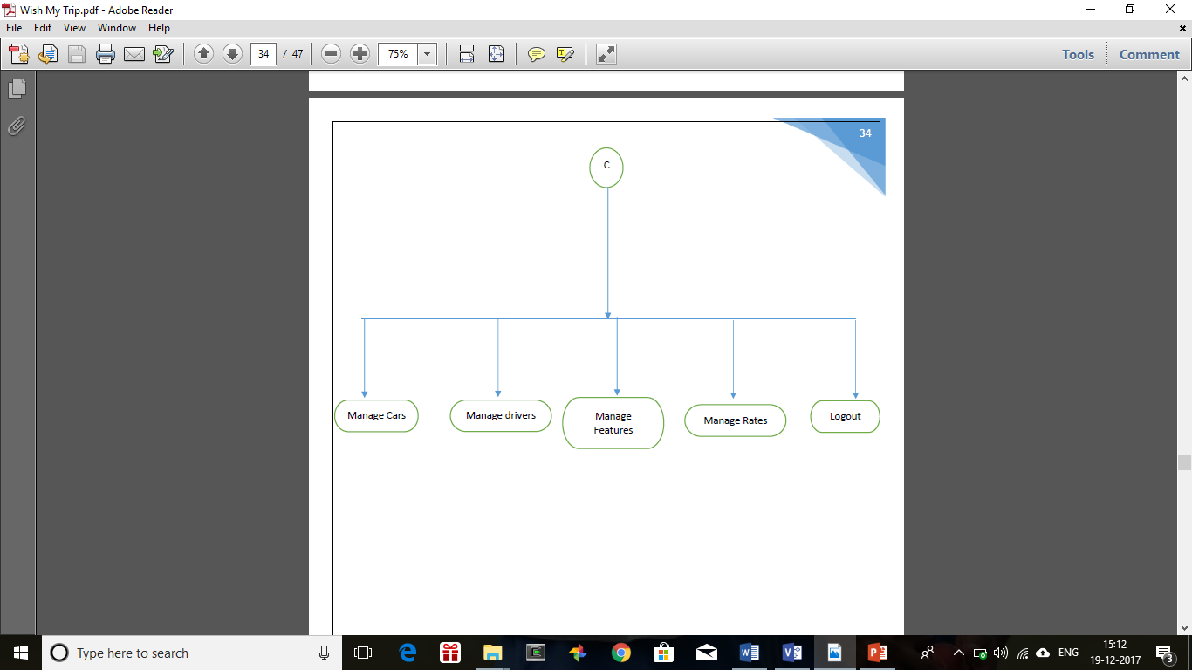

Slide 33
Data Dictionary

Slide 34
List of Tables
User
Car
Traveller
Driver
Order
Payment
Hotel
Feedback
City
State
Country

Slide 35
Car User
Field Name | Data Type | Size | Constraint | Description
car_id | Integer |  | Primary Key | Id of Car
car_name | varchar | 20 | Not Null | Name of Car
car_colour | varchar | 7 | Not Null | Colour of car
car_type | Boolean |  | Not Null
car_img | varchar | 200 | Not Null | Image of car
Car_rate | Double |  | Not Null | Price of Car
car_details | varchar | 100 | Not Null | Details of car
Car_category | Varchar | 10 | Not Null | Sedan or Suv
fk_traveller_id | Integer |  | Foreign Key | Id of traveller
Field Name | Data Type | Size | Constraint | Description
user_email_id | varchar | 40 | Primary Key | User’s email id
user_name | varchar | 20 | Not Null | Displays User’s name
user_photo | varchar | 200 | Not Null | Display User’s photo
user_password | varchar | 15 | Not Null | Password for login
user_address | varchar | 50 | Not Null | Address of user
User_dob | Date |  | - | Birthdate of User
User_gender | Boolean |  | Not Null | 0 or 1
User_mobileno | Varchar | 13 | Not Null | User’s Mobile no

Slide 36
Traveller Driver
Field Name | Data Type | Size | Constraint | Description
traveller_id | Integer |  | Primary Key | Id of traveller
traveller_name | varchar | 20 | Not Null | Name of traveller
traveller_password | varchar | 15 | Not Null | Password of traveller
fk_car_id | Integer |  | Foreign Key | Id of the car
traveller_email | varchar | 40 | Not Null | Email Id of Traveller
traveller_add | varchar | 50 | Not null | Address of traveller
Fk_driver_id | Integer |  | Not Null | Id of Driver
Fk_city_id | Integer |  | Not Null | Id of city
Field Name | Data Type | Size | Constarint | Description
Driver_id | Integer |  | Primary Key | Id of driver
Driver_name | Varchar | 30 | Not Null | Name of driver
Driver_license_no | Varchar | 25 | Not Null | License no of driver
Fk_traveller_id | Integer |  | Not Null | Id of traveller

Slide 37
Payment Order
Field Name | Data Type | Size | Constraint | Description
pay_id | Integer |  | Primary key | Id of payment
card_no | Long Integer |  | Not Null | No of the card
Amount | Double |  | Not Nulll | Amount of Trip
card_name | varchar | 15 | Not Null | Name of the Card
card_type | varchar | 15 | Not Null | Credit or Debit Card
fk_user_id | varchar | 40 | Foreign Key | Id of the user
Date | Date |  | Not Null | Date of payment
Status | Boolean |  | Not Null | Paid or Pending
Fk_order_id | Integer |  | Not Null | Order Id
Fk_traveller_id | Integer |  | Not Null | Id of traveller
Field Name | Data Type | Size | Constraint | Description
order_id | Integer |  | Primary Key | No of Order
fk_user_id | varchar | 40 | Foreign Key | Id of user
Source | varchar | 50 | Not null | Pick Up Location
Destination | varchar | 50 | Not Null | Destination Location
Booking-date | Date |  | Not Null | Date of trip
Checkin_date | Date |  | Not Null | Date of check in
checkout_date | Date |  | Not Null | Last date of trip
fk_car_id | Integer |  | Foreign Key | Car id
Fk_driver_id | Integer |  | Not Null | Id of driver
fk_traveller_id | Integer |  | Foreign Key | Traveller Id
booking_Status | Boolean |  | Not Null

Slide 38
Hotel Feedback
Field Name | Data Type | Size | Constraint | Description
hotel_id | Integer |  | Primary Key | Id of hotel
hotel_name | varchar | 20 | Not Null | Name of Hotel
hotel_address | varchar | 50 | Not Null | Address of hotel
hotel_img | varchar | 200 | Not Null | Image of hotel
hotel_feedback | varchar | 100 | - | Feedback of hotel
hotel ratings | Integer |  | - | Ratings of hotel
Fk_city_id | Integer |  | Foreign Key | Id of the city
Field Name | Data Type | Size | Constraint | Description
feedback_id | Integer |  | Primary Key | Id of blog
feedback _title | varchar | 10 | Not Null | Title of Blog
feedback_desc | varchar | 500 | - | Description of blog
feedback_date | Date |  |  | Date of blog
feedback _img | varchar | 200 | - | Image of blog
fk_user_id | varchar | 40 | Not Null | User Id

Slide 39
Country
Field Name | Data Type | Size | Constraint | Description
Country_name | Varchar | 10 | Not Null | Name of Country
Country_id | Integer |  | Primary Key | Id of City
State
Field Name | Data Type | Size | Constraint | Description
State_name | Varchar | 10 | Not Null | Name of state
State_id | Integer |  | Primary Key | Id of State
Fk_country_id | varchar | 10 | Not Null | Name of country
City
Field Name | Data Type | Size | Constraint | Description
city_id | Integer |  | Primary Key | Id of City
city_name | varchar | 10 | Not Null | Name of city
fk_State_id | Varchar | 10 | Not Null | Name of state

Slide 40
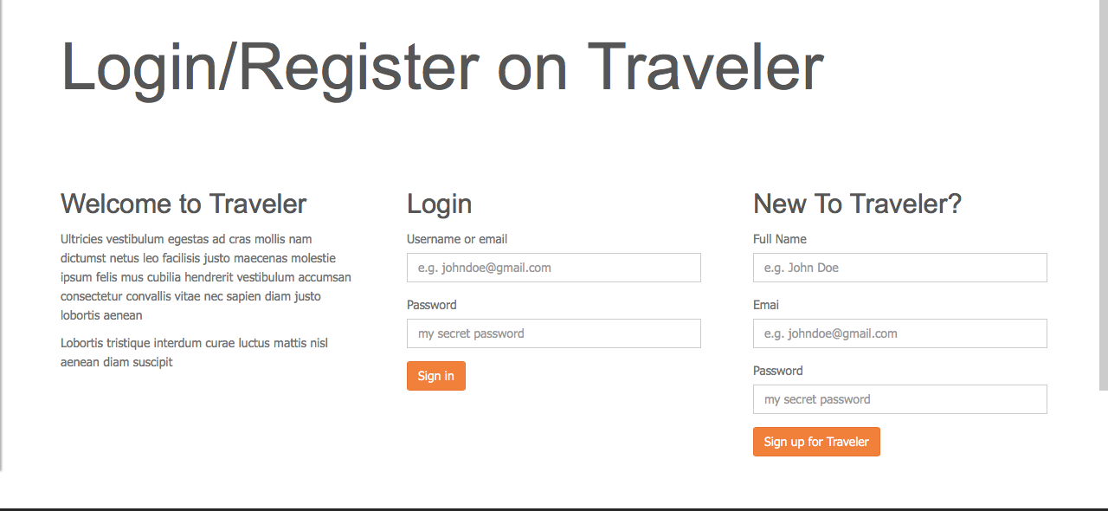
Login Page

Slide 41
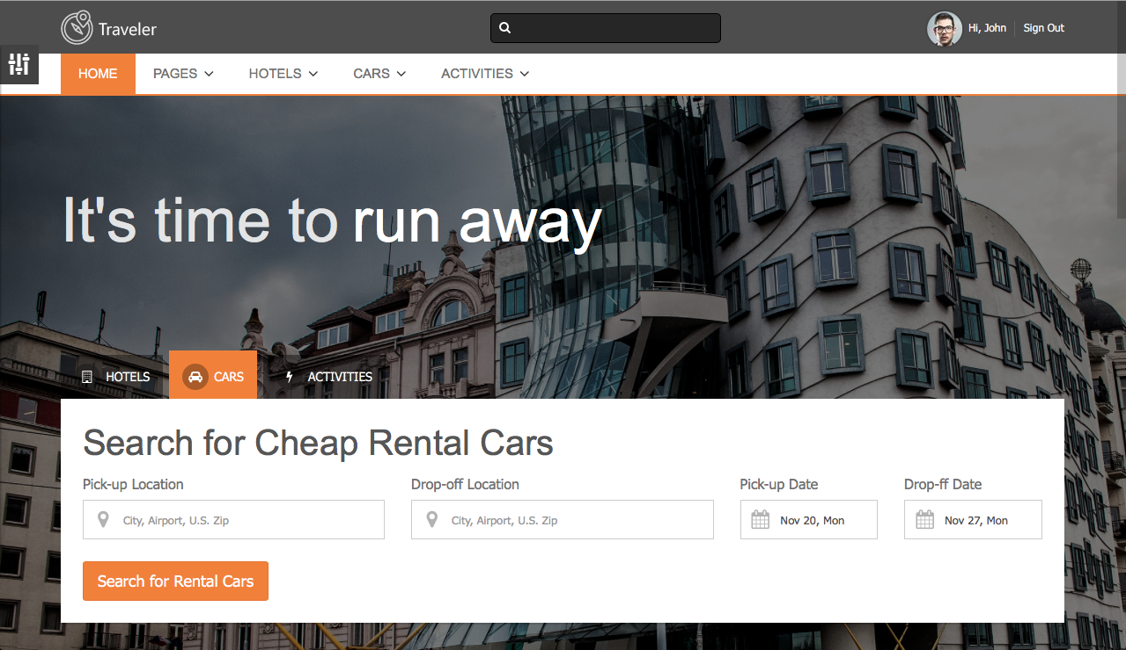
Homepage

Slide 42
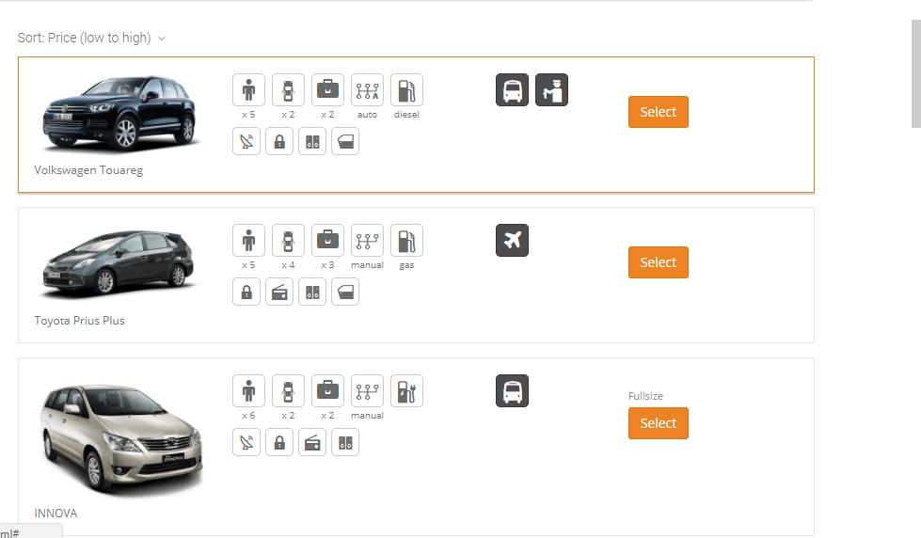
Select Cars

Slide 43
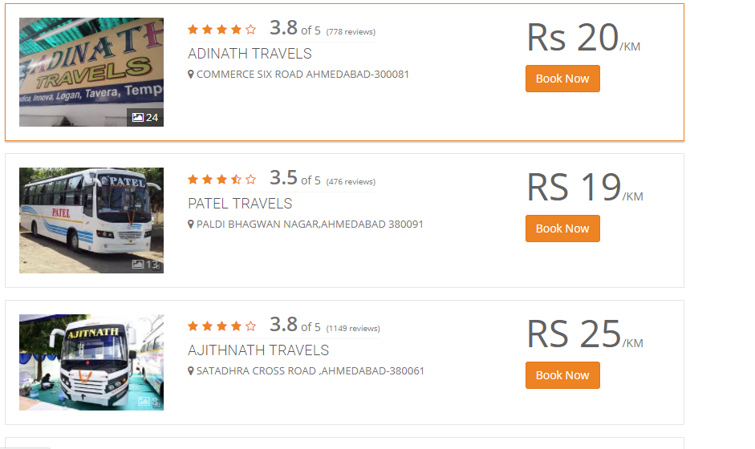
Select Traveller

Slide 44
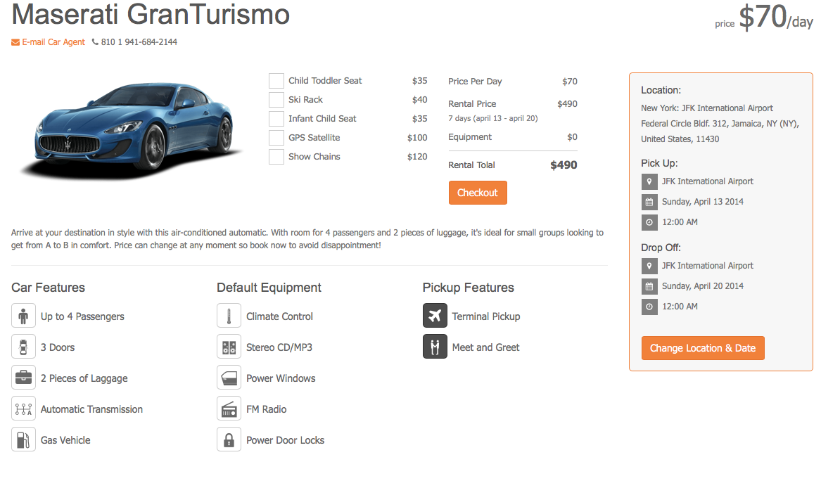
Car details

Slide 45
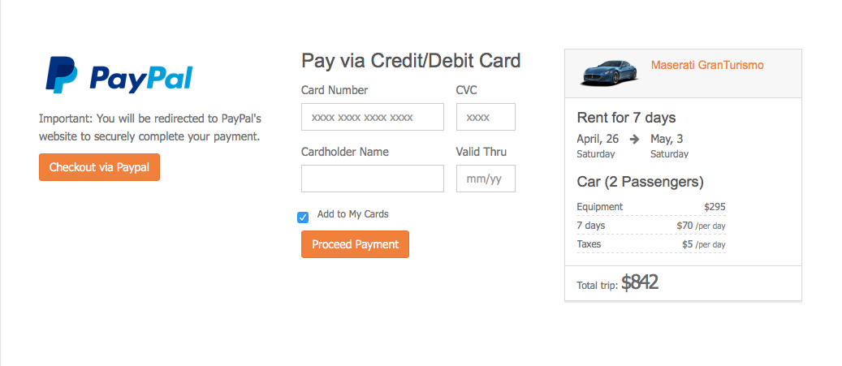
Payment

Slide 46
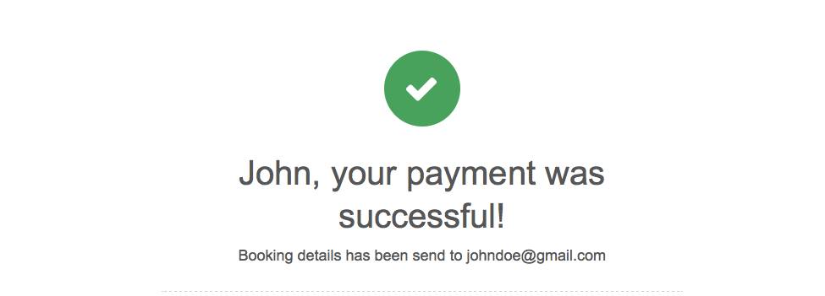
Successful

Slide 47
System Navigation

Slide 48
Limitations
Smart phone and Desktop will be required to use this system.
Without Internet facilities, the customer can’t use the system.
If the customer doesn’t have the basic knowledge about computer, then it will be difficult for them to use this system.
They can’t book the hotel.

Slide 49
Future Scope
More different types of offers such as Discount coupons will be provided to the customers based on booking records.
Paytm facility will be added for online payments.
We can add the facility of hotel Booking

Slide 50
Bibliography
http://www.rfflow.com/
https://moqups.com/
http://www.redbus.in/
http://www.microsoft visio.com/
http://makemytrip.com/

Slide 51
Thank You!

